Slide 1
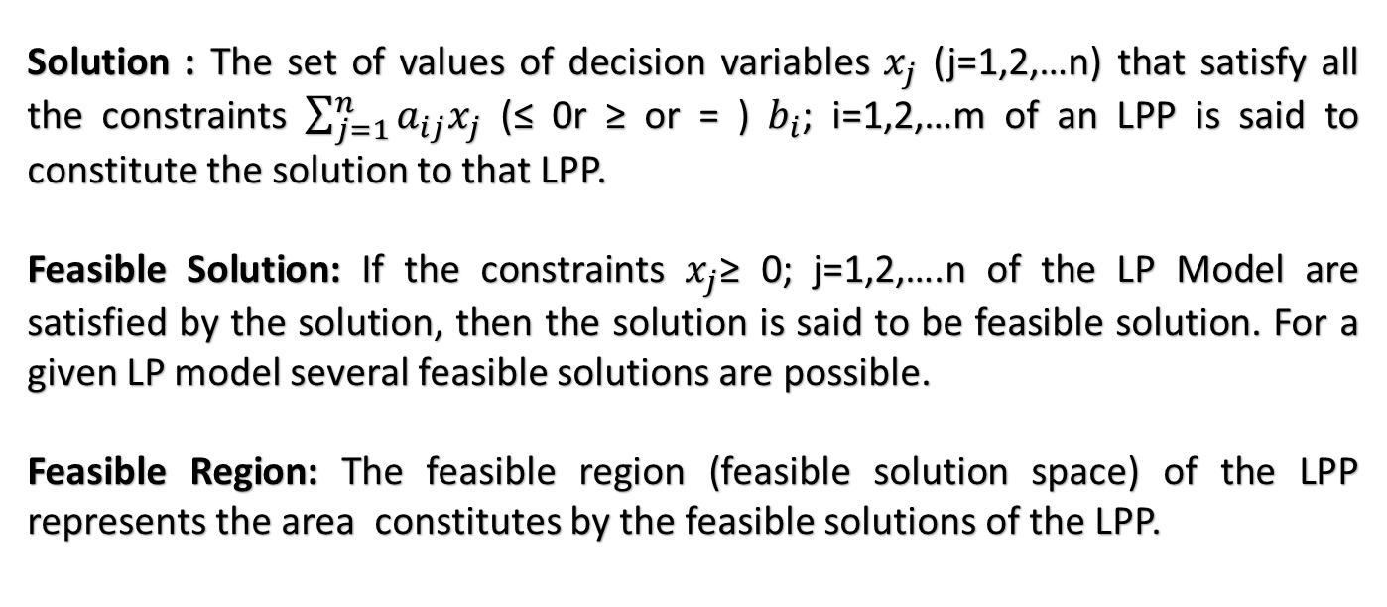
DEFINITIONS
Solution : The set of values of decision variables $x_{j}$ (j=1,2,…n) that satisfy all the constraints $\sum_{j=1}^{n}{a_{ij}x_{j}}$ (≤ 0r ≥ or = ) $b_{i}$; i=1,2,…m of an LPP is said to constitute the solution to that LPP.
Feasible Solution: If the constraints $x_{j}$≥ 0; j=1,2,….n of the LP Model are satisfied by the solution, then the solution is said to be feasible solution. For a given LP model several feasible solutions are possible.
Feasible Region: The feasible region (feasible solution space) of the LPP represents the area constitutes by the feasible solutions of the LPP.
Optimal feasible Solution: A feasible solution that results in the larger possible objective function value when maximizing (or Smallest when Minimizing) is called an Optimal feasible solution.

Slide 2
DEFINITIONS
Unbounded Solution: For some linear programming problems the objective function can be increased infinitely. In such cases the model is said to have unbounded solution which satisfies all the constraints but the decision variable values are infinite.
Infeasible Solution: For some linear programming problems no set of values of the decision variables satisfy all the constraints. In such a case the model is said to have Infeasible solution.
Alternative (or Multiple) Optimal Solutions:
A given LPP may have more than one feasible solution yielding the same Optimal objective function value. Each of such Optimal feasible solutions is termed as alternative optimal solution.

Slide 3
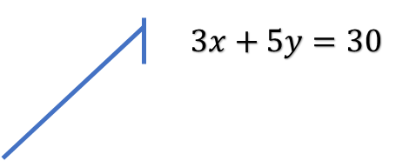
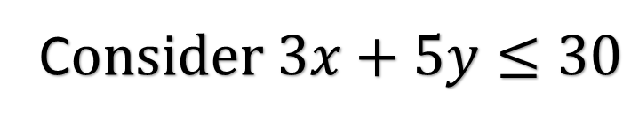
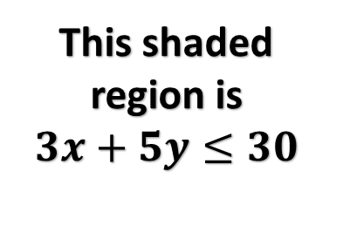
Graph of Linear Inequality
C$onsider 3x+5y≤30$
y
(0,6)
$$3x+5y=30$$
This shaded region is
$$3x+5y≤30$$
(10,0)
0
x

Slide 4
Extreme Point Theorem:
An Optimum Solution to a Linear Programming Problem, if it exists, occurs at one of the corner points of the feasible region(bounded/unbounded).

Slide 5
Methods to Solve a LP Model
(To find the Optimal feasible solution)
Graphical Method – If no. of variables is only two
Simplex method
One Phase Method
Big M Method
Two Phase Method
Dual Simplex Method
Revised Simplex Method
Bounded variables Method

Slide 6
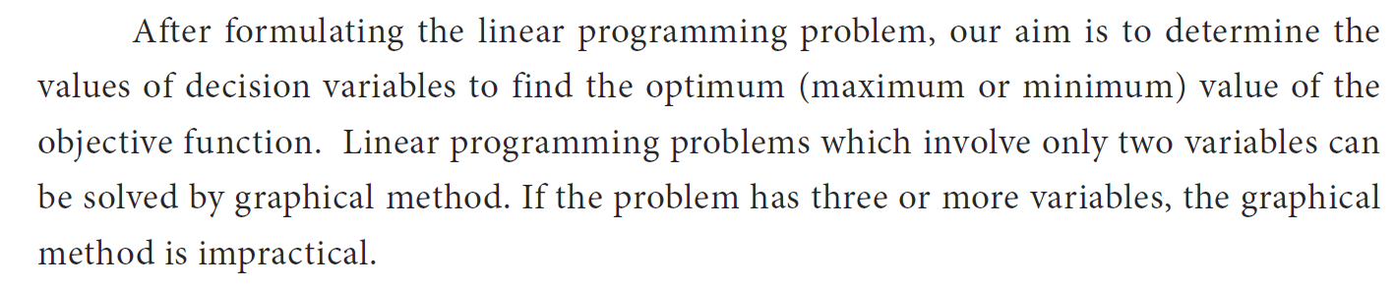
Graphical Method

Slide 7
Summary of the Graphical Solution Procedure for Maximization Problems:(Extreme Point Solution Method)
Formulate the appropriate Linear programming model of the given decision problem
Draw the graphs of the constraints.
Determine the feasible region that satisfies all the constraints simultaneously.
Find the corner points of the feasible region
Evaluate the value of objective function at each of the corner points.
In case of maximization problem, the corner point at which the objective function has a maximum value represents the optimal solution
In case of minimization problem, the corner point at which the objective function has a minimum value represents the optimal solution

Slide 8
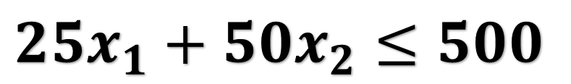
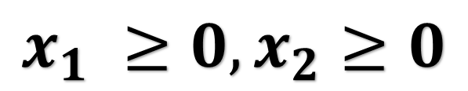
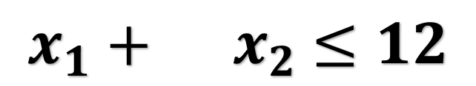
Example to solve LPP using Graphical Method
Consider the previously discussed Fruit-Sellers Problem.
LP Model 1
$$Maximize Z=6x_{1}+10x_{2}$$
Subject to
$$25x_{1}+50x_{2}≤500$$
$$x_{1} +{ x}_{2} ≤12$$
$$x_{1} ≥0,x_{2}≥0$$

Slide 9



$$x_{2}$$
$$x_{1} +x_{2}≤12$$
$$x_{1}$$

Slide 10

$$x_{2}$$
$$25x_{1}+50x_{2}≤500$$
$$x_{1}$$

Slide 11
$$x_{2}$$
$$x_{2}$$
$$25x_{1}+50x_{2}≤500$$
Feasible Region
$$x_{1} +x_{2}≤12$$
$$x_{1}$$
$$x_{1}$$

Slide 12
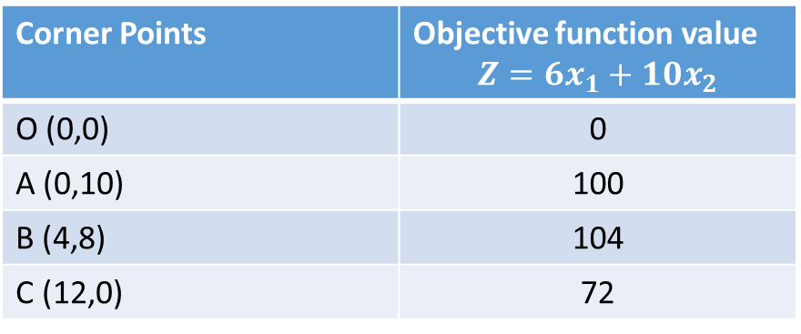
$$x_{2}$$
Corner Points | Objective function value $$Z=6x_{1}+10x_{2}$$
O (0,0) | 0
A (0,10) | 100
B (4,8) | 104
C (12,0) | 72
A (0,10)
B (4,8)
C (12,0)
$$x_{1}$$
O (0,0)

Slide 13
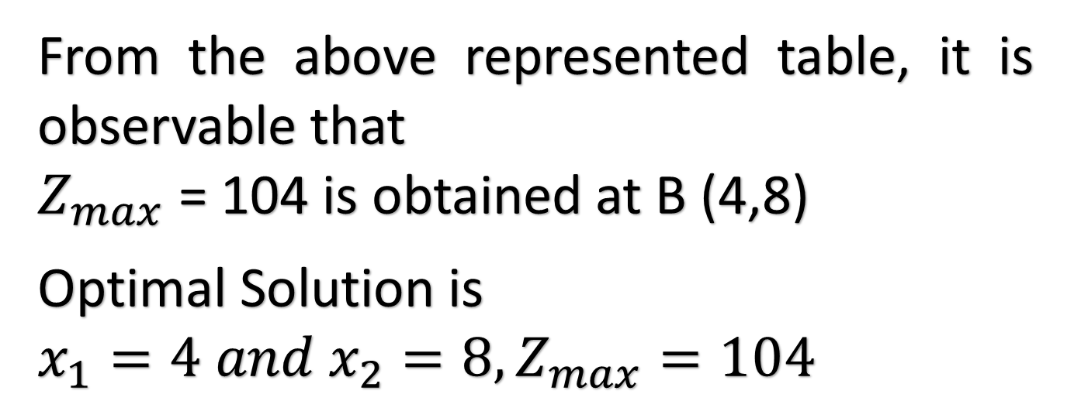
From the above represented table, it is observable that
$Z_{max}$ = 104 is obtained at B (4,8)
Optimal Solution is
$$x_{1}=4 and x_{2}=8,Z_{max}=104$$

Slide 14
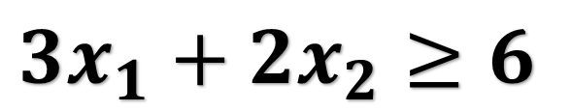
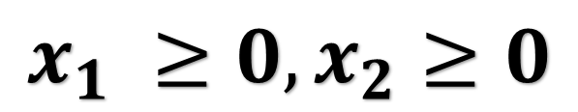
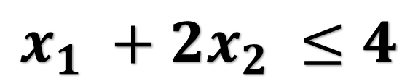
Another example to solve LPP using Graphical Method
LP Model 2
$$Maximize Z=2x_{1}+5x_{2}$$
Subject to
$$3x_{1}+2x_{2}≥6$$
$$x_{1} +{2x}_{2} ≤4$$
$$x_{1} ≥0,x_{2}≥0$$

Slide 15

$$x_{2}$$
$$3x_{1} +2x_{2}≥6$$
$$x_{1}$$

Slide 16
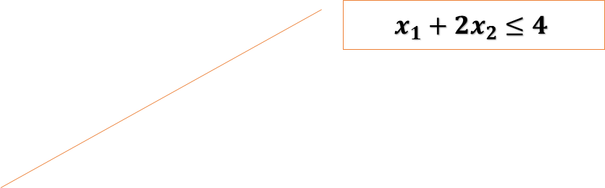
$$x_{2}$$
$$x_{1}+2x_{2}≤4$$
$$x_{1}$$

Slide 17
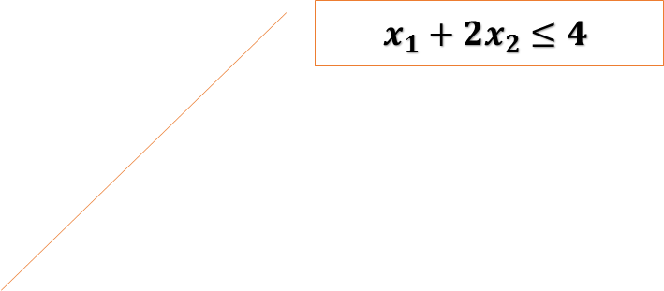

$$x_{2}$$
$$x_{2}$$
$$3x_{1} +2x_{2}≥6$$
$$x_{1}+2x_{2}≤4$$
Feasible Region
$$x_{1}$$
$$x_{1}$$

Slide 18
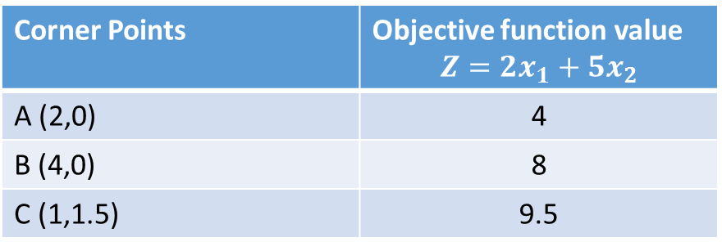
Corner Points | Objective function value $$Z=2x_{1}+5x_{2}$$
A (2,0) | 4
B (4,0) | 8
C (1,1.5) | 9.5
C (1,1.5)
Feasible Region
B (4,0)
A (2,0)
$$x_{1}$$

Slide 19
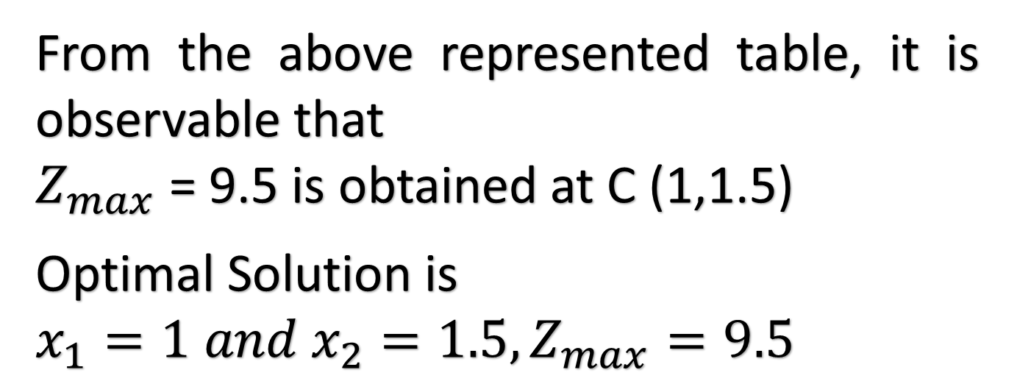
From the above represented table, it is observable that
$Z_{max}$ = 9.5 is obtained at C (1,1.5)
Optimal Solution is
$$x_{1}=1 and x_{2}=1.5,Z_{max}=9.5$$

Slide 20
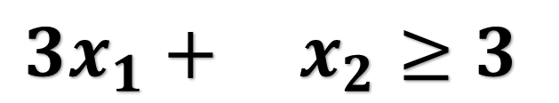
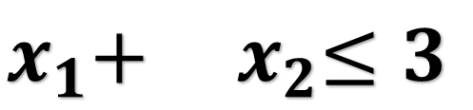
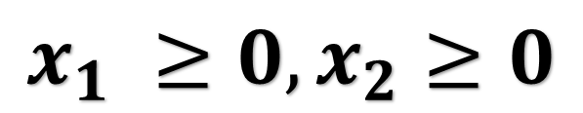
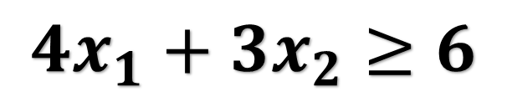
Example 3 to solve LPP using Graphical Method
LP Model 3
$$Minimize Z=3x_{1}+2x_{2}$$
Subject to
$$3x_{1}+ x_{2}≥3$$
$$4x_{1}+{3x}_{2}≥6$$
$$x_{1}+{ x}_{2}≤3$$
$$x_{1} ≥0,x_{2}≥0$$

Slide 21

$$x_{2}$$
$$3x_{1}+ x_{2}≥3$$
$$x_{1}$$

Slide 22
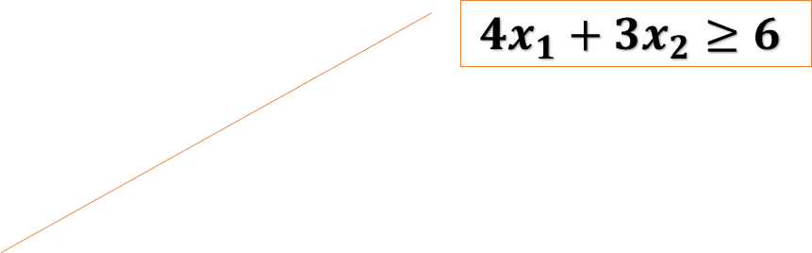
$$x_{2}$$
$${4x}_{1}+3x_{2}≥6$$
$$x_{1}$$

Slide 23
$$x_{2}$$
$$x_{1} +x_{2}≤3$$
$$x_{1}$$

Slide 24
$$x_{2}$$
$$x_{2}$$
$$x_{2}$$
$${4x}_{1}+3x_{2}≥6$$
$$3x_{1}+ x_{2}≥3$$
Feasible Region
$$x_{1} +x_{2}≤3$$
$$x_{1}$$
$$x_{1}$$
$$x_{1}$$

Slide 25
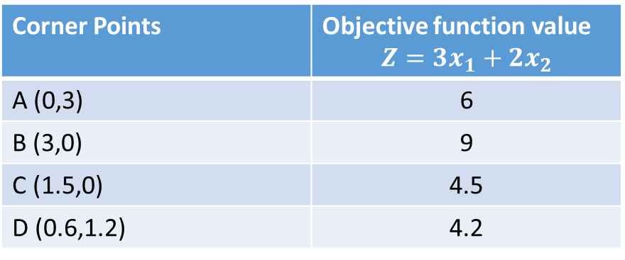
$$x_{2}$$
Corner Points | Objective function value $$Z=3x_{1}+2x_{2}$$
A (0,3) | 6
B (3,0) | 9
C (1.5,0) | 4.5
D (0.6,1.2) | 4.2
A (0,3)
Feasible Region
D (0.6,1.2)
B (3,0)
C (1.5,0)
$$x_{1}$$

Slide 26
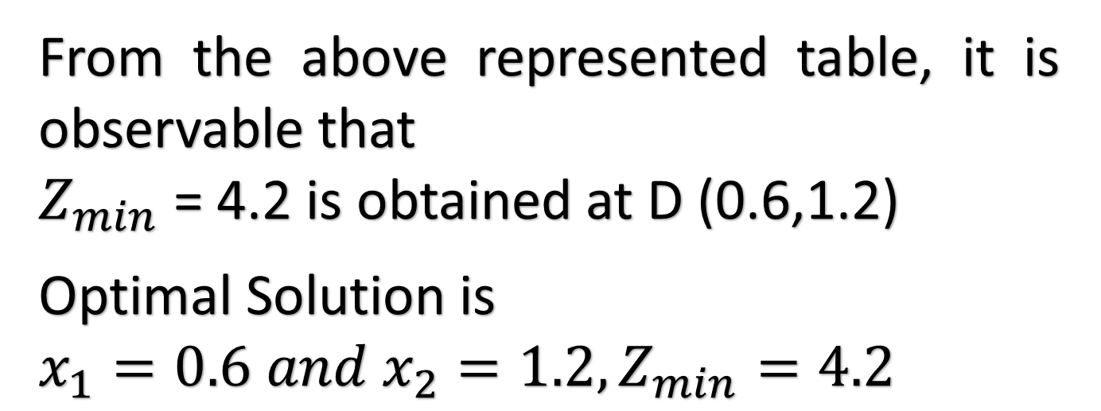
From the above represented table, it is observable that
$Z_{min}$ = 4.2 is obtained at D (0.6,1.2)
Optimal Solution is
$$x_{1}=0.6 and x_{2}=1.2,Z_{min}=4.2$$

Slide 27
IRREGULAR TYPES OF LINEAR PROGRAMMING PROBLEMS
Special types of problems include those with:
Redundancy
Infeasible solutions
Unbounded solutions
Multiple optimal solutions

Slide 28
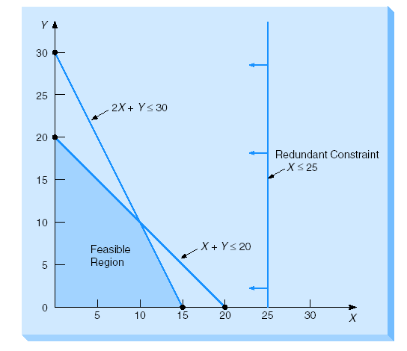
Redundancy: A redundant constraint is a constraint that does not affect the feasible region in any way.
Maximize Profit
= 2X + 3Y
subject to:
X + Y ≤ 20
2X + Y ≤ 30
X ≤ 25
X, Y ≥ 0

Slide 29
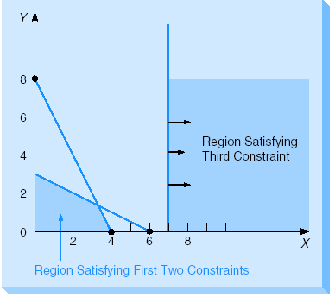
Infeasibility: A condition that arises when an LP problem has no solution that not satisfies all of its constraints.
X + 2Y ≤ 6
2X + Y ≤ 8
X ≥ 7

Slide 30
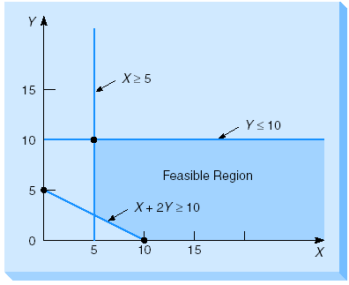
Unboundedness: Sometimes an LP model will not have a finite solution
Maximize profit
= $3X + $5Y
subject to:
X ≥ 5
Y ≤ 10
X + 2Y ≥ 10
X, Y ≥ 0

Slide 31
MULTIPLE OPTIMAL SOLUTIONS
An LP problem may have more than one optimal solution.
Graphically, when the isoprofit (or isocost) line runs parallel to a constraint in the problem which lies in the direction in which isoprofit (or isocost) line is located.
In other words, when they have the same slope.

Slide 32
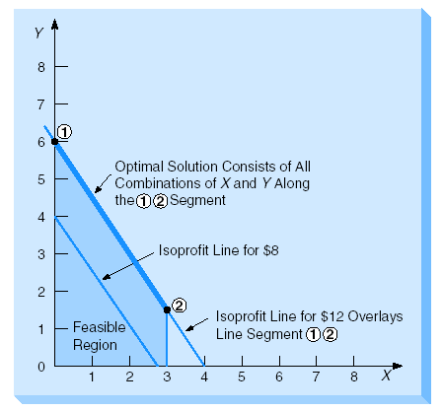
EXAMPLE: MULTIPLE OPTIMAL SOLUTIONS
At profit level of $12, isoprofit line will rest directly on top of first constraint line.
This means that any point along the line between corner points 1 and 2 provides an optimal X and Y combination.

